Slide 1
Capstone Project: Biodiversity for the National Parks
Ing. Nina Chromá

Slide 2
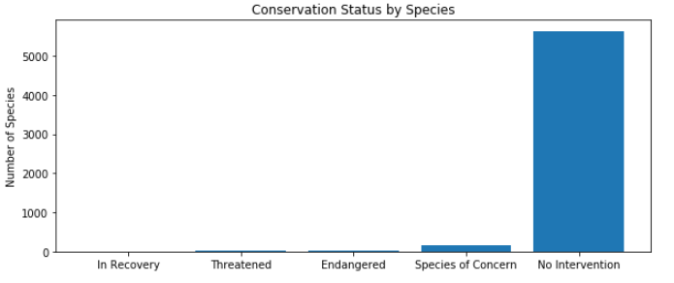
Data description
Input data are in ’species_info.csv’ file.
There is 5541 different species in 7 categories:
- Mammal, Bird, Reptile, Amphibian, Fish, Vascular Plant, Nonvascular Plant
and in 5 conservational status:
- Endangered, In Recovery, Species of Concern, Threatened, No Intervention

Slide 3
We should discover, if certain types of species are more likely to be endangered.
In a pivot table it looks like species in category Mammal are more likely to be endangered than species in Bird. This can be solved with a chi squared test.
First we need contingency table:
 | protected | not protected
Mammal | 30 | 146
Bird | 75 | 413
Then we can run the chi squared test function from scipy . The result is P-value: 0.6875
Because the p-value is greater then 0.05 this difference isn't significant.
Another case was the difference between Reptile and Mammal.
P-value in this case is 0.0384
We can say there is a significant difference between Reptile and Mammal!

Slide 4
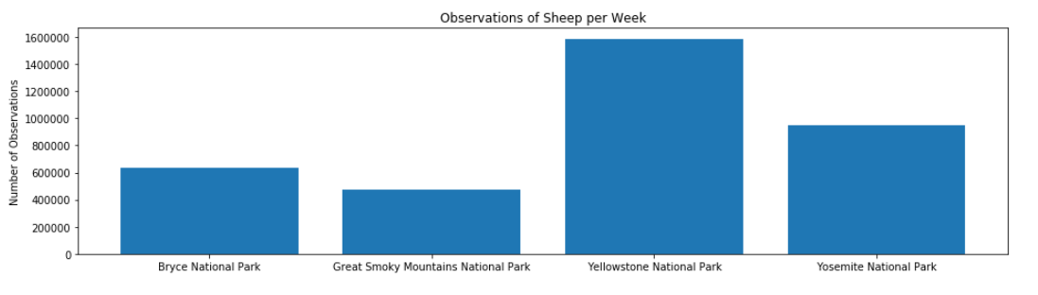
Next in the project we got file called observations.csv, that contains information about number of sheep sightings at different national parks. I merged species file woth observations file, to get whole information about species (sheeps) and their observation of foot and mouth disease. So we can make th picture of the total number of sheep observed in each park over the past 7 days:

Slide 5

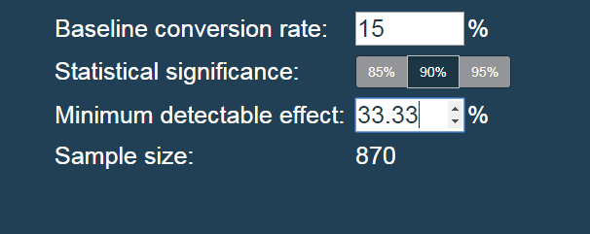
Our scientists know that 15% of sheep at Bryce National Park have foot and mouth disease. Park rangers at Yellowstone National Park have been running a program to reduce the rate of foot and mouth disease at that park. The scientists want to test whether or not this program is working. They want to be able to detect reductions of at least 5 percentage points. For instance, if 10% of sheep in Yellowstone have foot and mouth disease, they'd like to be able to know this, with confidence.
We should calculate the number of sheep that they would need to observe from each park, with significance level of 90%. Sample size we can calculate with calculator, but we need to know minimum detectable effect, which we calculate as: Minimum detectable effect is 33.33%.
This number we put in the calculator and we see, that sample size should be 870 sheeps.

Slide 6

How many weeks would you need to observe sheep at Bryce National Park and at Yellowstone National Park in order to observe enough sheep?
Here is the calculation:
The result is:
For Bryce National Park we need 3.48 weeks and for Yellowstone National Park: 1.72 weeks.

